Slide 1
Data Visualization

Slide 2
Basics
Imani Palmer - ipalmer2@illinois
Office Hours:
Github: https://github.com/inp2/Data-Viz-Fall2018
Classroom: https://classroom.github.com/classrooms/41658328-lis-590-data-visualization-fall-2018
Slack:

Slide 3
Schedule
Week 1 (Aug 27th - Aug 31st): Introduction, syllabus, examples of visualization, and installation of packages (jupyter notebook, & python)
Week 2 (Sept 3rd - Sept 7th): Dealing with Data
Week 3 (Sept 10th - Sept 11th): Basic Principles of Data Visualization
Week 4 (Sept 17th - Sept 21st): Simple Plotting: Quantitative Plots
Week 5 (Sept 24th - Sept 28th): Binning Filtering, Smoothing, Multiplots, Histograms, & Distributions
Week 6 (Oct 1st - Oct 5th): Images: color theory, colormaps, generating visualizations of images and image-like quantities
Week 7 (Oct 8th - Oct 12th): Geospatial visualizations
Week 8 (Oct 15th - Oct 19th): Synthesizing multiple datasets
Week 8 (Oct 22nd - Oct 26th): Software ecosystem around visualization
Week 9 (Oct 29th - Nov 2nd): Network visualization
Week 10 (Nov 5th - Nov 9th): Statistical visualization
Week 11 (Nov 12th - Nov 16th): Interactive visualizations
Week 12 (Nov 19th - Nov 23rd): Thanksgiving Break
Week 13: (Nov 26th - Nov 30th): Advanced visualizations
Week 14 (Dec 4th - Dec 7th): Group presentations

Slide 4
Overview - Themes
What are the components of an effective visualization of quantitative data?
What tools and ecosystems are available for visualizing data?
What systems can be put in place to generate visualizations rapidly and with high-fidelity representation?

Slide 5
Overview - Goals
Students will be able to communicate information and data through visual representation
Students will be able to examine a visualization and understand how it can be improved upon
Students will have facility with the commonplace tools used for visualization, and a deeper understanding of where those tools have shortcomings

Slide 6
Overview - Grading
Assignments worth 60%
Final project worth 40%

Slide 7
Overview - Assignments

Slide 8
Visualizations
Notes:
Religious identity across Greater London

Slide 9
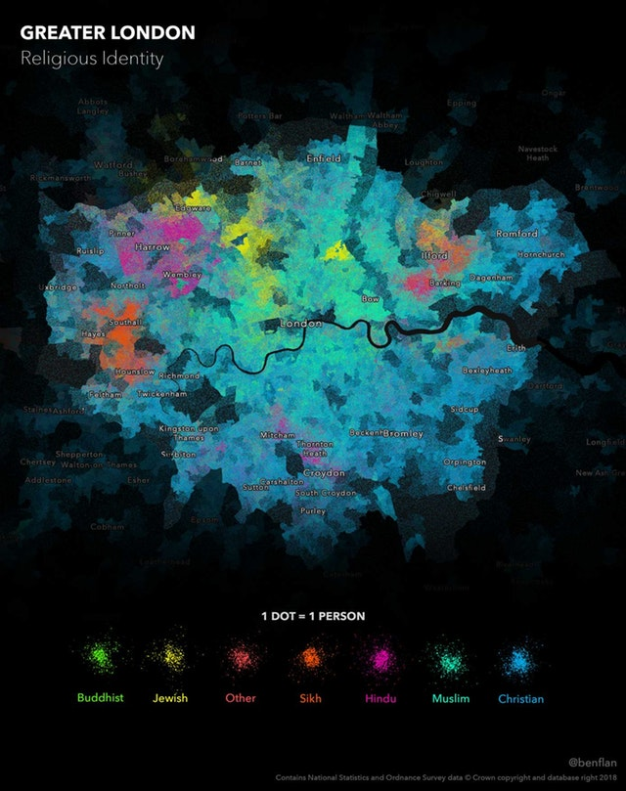
Notes:
Religious identity across Greater London
US County Diurnal Air Temperature by Month

Slide 10
Norse Attack Map

Slide 11
Clustergrammar

Slide 12
Overview - Github
Github Classroom:
https://classroom.github.com/classrooms/41658328-lis-590-data-visualization-fall-2018
Signing up for Github Classroom
Sign up for a Github account if you do not already have one
Tutorial for those new to github
https://guides.github.com/activities/hello-world/

